Slide 1

Functional Programming

Slide 2
What is functional programming?

Slide 3

What is functional programming?
“In computer science, functional programming is a programming paradigm where programs are constructed by applying and composing functions.”
Programming Paradigms
Imperative
Procedural
Object-orientated
Declarative
Functional
Logic
SQL
Notes:
Programming paradigms – a way to classify programming languages based on their features.

Slide 4
Other features

Slide 5
Immutability
let x = 1
x = 2 // Not allowed
Notes:
First class citizen - In programming language design, a first-class citizen in a given programming language is an entity which supports all the operations generally available to other entities. These operations typically include being passed as an argument, returned from a function, and assigned to a variable.

Slide 6
Pure functions
// Not pure
var count = 1
function incrementCount(){
return count + 1;
}
// Pure
let incrementCount(count) =
count + 1
Notes:
First class citizen - In programming language design, a first-class citizen in a given programming language is an entity which supports all the operations generally available to other entities. These operations typically include being passed as an argument, returned from a function, and assigned to a variable.

Slide 7
Functions as first class citizens
function add(a, b) {
return a + b
}
let total = add(1, 2)
Notes:
First class citizen - In programming language design, a first-class citizen in a given programming language is an entity which supports all the operations generally available to other entities. These operations typically include being passed as an argument, returned from a function, and assigned to a variable.

Slide 8
function createAdder(getAmount) {
return (x) -> x + getAmount()
}
Notes:
First class citizen - In programming language design, a first-class citizen in a given programming language is an entity which supports all the operations generally available to other entities. These operations typically include being passed as an argument, returned from a function, and assigned to a variable.

Slide 9
public class Multiplier {
public int Factor;
public int Calculate(int value) {
return value * Factor;
}
}
var tenMultiplier = new Multiplier { Factor = 10 };
var result = tenMultiplier.Calculate(2);
Notes:
First class citizen - In programming language design, a first-class citizen in a given programming language is an entity which supports all the operations generally available to other entities. These operations typically include being passed as an argument, returned from a function, and assigned to a variable.

Slide 10
function createMultiplier (factor) {
return (x) -> x * factor
}
let multiplyByTen = createMultiplier(10)
let result = multiplyByTen(2)
Notes:
First class citizen - In programming language design, a first-class citizen in a given programming language is an entity which supports all the operations generally available to other entities. These operations typically include being passed as an argument, returned from a function, and assigned to a variable.

Slide 11
Putting it all together…

Slide 12
Function filter(people) {
let results = new List<Person>()
for person in people do {
if person.Age > 30 then
results.Add(person)
}
return results
}

Slide 13
function filter(age, people) {
let results = new List<Person>()
for person in people do {
if person.Age > age then
results.Add(person)
}
return results
}

Slide 14
function filter(people) {
let results = new List<Person>()
for person in people do
if person.Gender == 'male' then
results.Add(person)
Results
}

Slide 15
function filter(filterFunction, people) {
let results = new List<Person>()
for person in people do {
if filterFunction() then
results.Add(person)
}
return results
}

Slide 16
function filter(filterFunction, people) {
let results = new List<Person>()
for person in people do {
if filterFunction() then
results.Add(person)
}
return results
}
filter((p -> p.Age > 30), people)
filter((p -> p.Age > 40), people)
filter((p -> p.Gender == 'male'), people)

Slide 17
let isOver30 = (p) -> p.Age > 30
let isOver40 = (p) -> p.Age > 40
let isMale = (p) -> p.Gender == 'male'
filter(isOver30, people)
filter(isOver40, people)
filter(isMale, people)

Slide 18
filter(isOver30, people)
people |> filter(isOver30)

Slide 19
people |> filter(isOver30)
|> filter(isMale)

Slide 20
Downsides
Learning curve
Performance
Unit testing

Slide 21
Functional support in popular languages

Slide 22
JavaScript
Functions as first class citizens
Closures
Anonymous functions

Slide 23
JavaScript
Lodash
const menOver40 = _(people)
.filter(p => p.Age > 40)
.filter(p => p.Gender == 'male')
.value();

Slide 24

Python
Functions as first class citizens
Closures
Anonymous functions

Slide 25
Python
Built in functions (map, filter)
over40 = filter(isOver40, people)
menOver40 = filter(isMale, over40)

Slide 26
Python
Generator expressions
List comprehensions
over40 = [person for person in people
if isOver40(person)]
menOver40 = [person for person in over40 if isMale(person)]

Slide 27

Python
Itertools module
from itertools import chain
menOver40 = chain(
filter(isOver40, people),
filter(isMale, people)
)

Slide 28
Python
Pipe module
from pipe import where
menOver40 = people
| where(isOver40)
| where(isMale)

Slide 29
C#
Functions as first class citizens
Closures
Anonymous functions
Records
Pattern matching

Slide 30
C#
LINQ (.NET Framework 3.5)
menOver40 = people
.filter(isOver40)
.filter(isMale);

Slide 31
Java
Functions as first class citizens
Closures
Anonymous functions

Slide 32
Java
Streams (Java 8)
menOver40 = people
.stream()
.filter(isOver40)
.filter(isMale)
.collect(Collectors.toList());

Slide 33
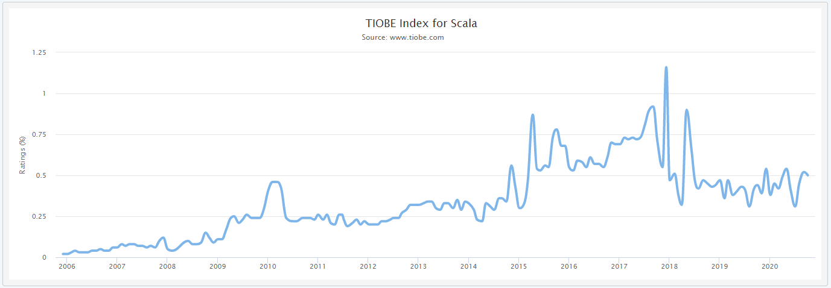
Losing popularity?

Slide 34
I want to learn more!
Learn as a functional language:
Functional ‘first’ – Scala, F#
Pure functional - Haskell

Slide 35
Questions?

